Slide 1
SCOOP NYC
Evan Thai
Rajwinder Kaur
Brian Engels
Margaret Caffrey
Sharon Haase

Slide 2
Background
Scoop NYC’s iconic fashion boutiques offer a highly edited selection of the season’s best styles for women and men.
The SCOOP NYC database is designed for the particular location in New York’s Meatpacking District.
http://scoopnyc.weebly.com/

Slide 3
Database Design
Our database contains
5 tables (excluding the Switchboard Table)
5 Queries using:
Calculated fields
One or more tables

Slide 4
User Interface
Our database consists of:
3 main forms, and 2 sub forms
6 reports based off of various queries
Features a user friendly switchboard to access forms and reports
Includes help and exit command buttons

Slide 5
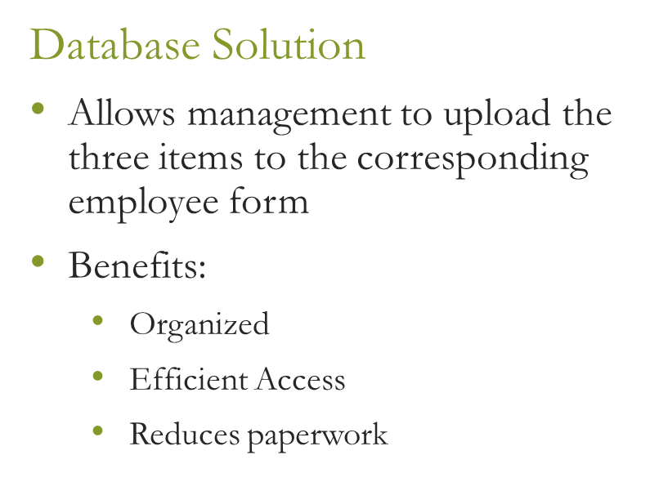
Business Problem: Excessive Paperwork
Previous Method
SCOOP NYC must collect physical copies of new hires’:
Résumé
Tax Form
Picture ID

Slide 6
Business Problem: Commissions Tracking
Previous Method
Database Solution
Excel Spreadsheet
Flaws:
Difficult to track commission rate increases
Lack of security
Database produces an up-to-date report of every employees’ commission rate and bonus.
Based on anniversary report
Automatically calculates amount of years worked by each employee

Slide 7
Business Problem: Employee Discounts
Previous Method
Database Solution
Cashiers applied large discounts to employees.
Receipts of employee discounts are often misplaced
Cashiers must list the employee using an employee discount
Management can track the exact amount of discount given through the report.

Slide 8
Business Value
Database will be helpful to all positions of SCOOP NYC
Excess paperwork will be eliminated
Overall operations will be streamlined
Time efficient
Effective procedures

Slide 9
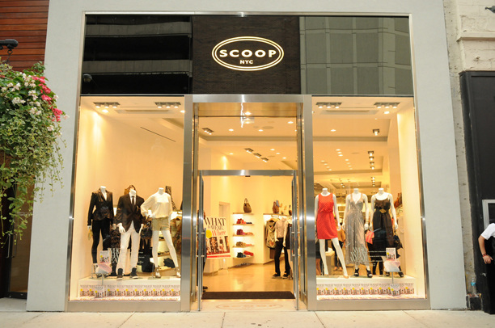
Thank You!

